Slide 1
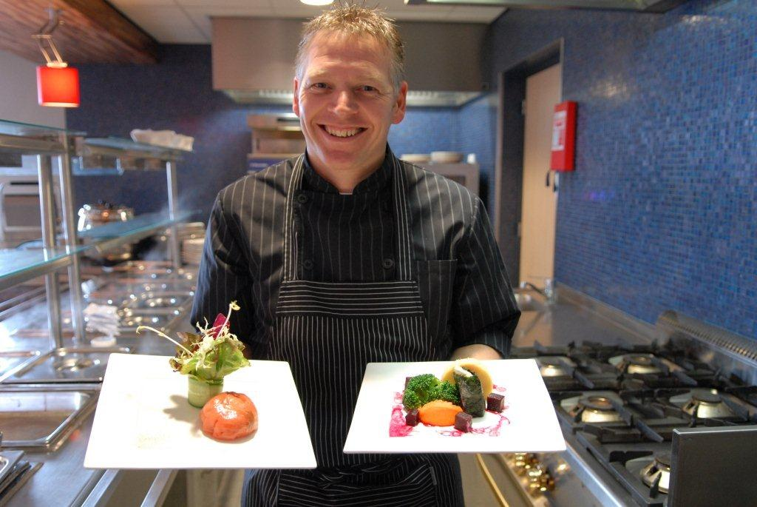
Introducing:
The Friendly Kitchens Alliance

Slide 2
Set up to...
Promote the use of ‘ friendly food’ in:
Restaurants
Institutional Kitchens

Slide 3
Friendly food..??!
Animal friendly produced
Friendly for the environment
And so...
Friendly for us!

Slide 4
2008:the birth of a new campaign!
Delicious Dishes
Promoting better – regional, organic, fresh and ‘ friendly’(!) - food in institutional kitchens

Slide 5

How it all started...
2007: The Netherlands celebrated their first
‘ National Week of Taste’
An ‘ode’ to ‘ friendly food’ from Dutch origine.

Slide 6
Placemat De Mooie Maaltijd 2011

Slide 7
Key values
(Good Taste Manifest):
Regional
Seasonal
Artisanal
Sustainable
Animal friendly
Fair

Slide 8
Delicious Dishes aims at:
Hospitals
Care and Nursing Homes
‘ Meals on wheels’
In short:
Better quality food for elderly and sick people, who are dependant on others to provide them with meals.

Slide 9
Why this campaign..?
Food in hospitals and care homes too often:
Boring, bad or no taste at all
Badly presented
Served without... care!

Slide 10
Malnutrition
20 - 25% of elderly people in care homes and nursing homes
15 - 25 % of elderly people receiving care (and meals) at home
25 - 40% of elderly people in hospitals

Slide 11
The Netherlands are ageing fast...
2010: Over 2,6 milion over 65
(15,6% of the total population)
2011 top year in the ageing proces: 120.000 new pensioners.
2040: 25,6% of the population is 65+:
4.6 milion people

Slide 12
Delicious Dishes...
Placing food back in the heart of good care!

Slide 13
Remedy / recipy:
Malnutrition
Enjoyment around mealtime
Sustainable food
Regional Economy

Slide 14
Interesting market for regional producers
Every day 1 milion mensen are to be reached in hospitals and care homes with ‘food & beverage’

Slide 15
Hospital supporting regional economy

Slide 16
Thresholds
Supply
Quality
Prejudice
No demand
Notes:
Hoe meer kennis over bio, hoe positiever de houding. De vraag van bewoners zal in de toekomst zeker toenemen. Immers: dat zijn de consumenten van nu, die op steeds meer plekken in aanraking komen met biologische producten. Denk aan b.v. La Place, de vele bedrijfsrestaurants (Albron). Bio, hoe bijzonder lekker ook, wordt steeds gewoner.

Slide 17
And…
Price…
Prejudice: regional/organic = expensive!
Notes:
Er zijn nog allerlei mogelijkheden ter beperking van projsverschillen. Volgens zodadelijk.

Slide 18

Chicken & Egg

Slide 19
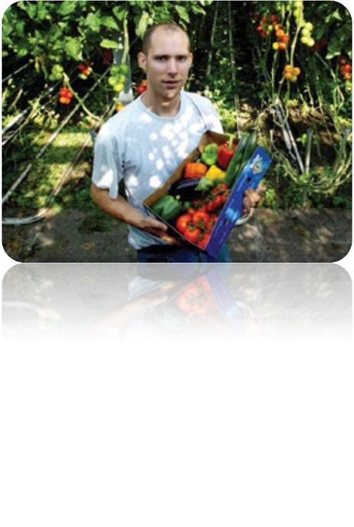
Needed: ‘guaranteed’ demand /turnover
Notes:
Om het aanbod goed en evenwichtig te laten groeien zijn er afspraken nodig over langere termijn afzetmogelijkheden. Dat biet ok kans tot afspraken over welke producten u zou willen, ofwel het maken van teeltplannen.

Slide 20
Solutions
Cooperation with a cooperation of small(er) and regional producers
Choose seasonal products
Shorten the chain where possible
Clever cooperation between big and small companies.
Notes:
Extra oplossing: Kopen hele koe, gebruiken alle delen.

Slide 21
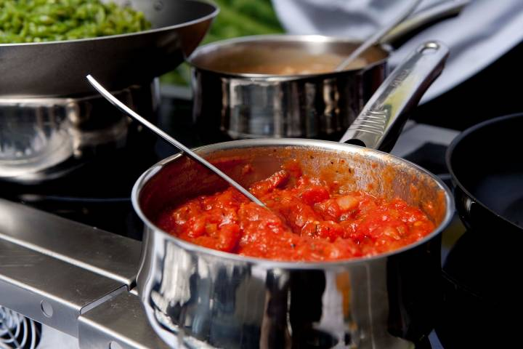
Fresh, seasonal, regional

Slide 22
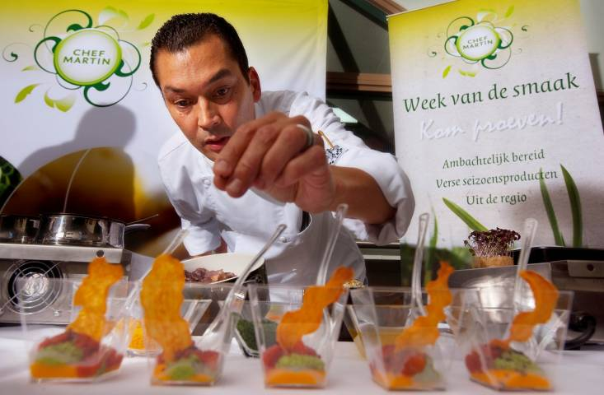
Prepared artisanally and with care! …

Slide 23
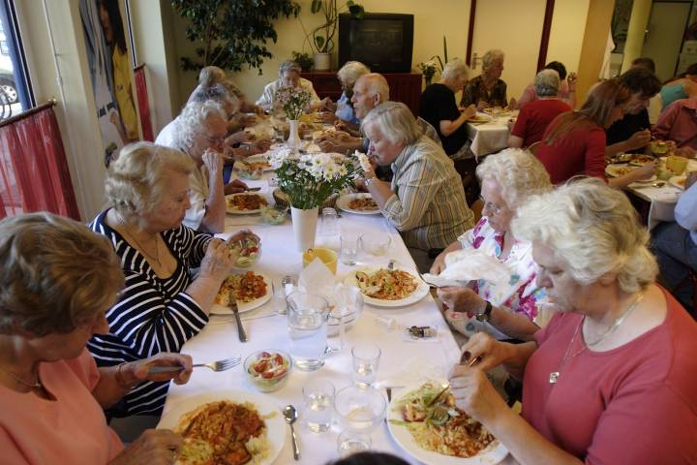
Enjoyed in a nice ambiance!

Slide 24
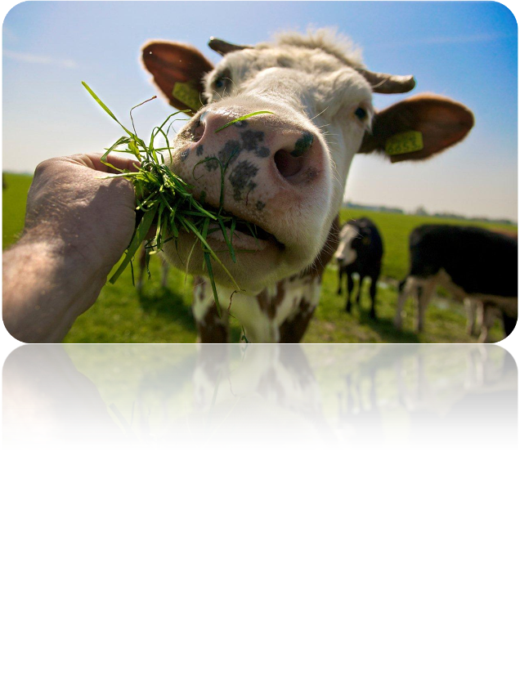
Kortom: voldoende denkvoer om nog eens op te kauwen!

